Slide 1
Percentage Skills Review Lesson 2
Year 11 Essentials

Slide 2

Learning Intentions
Can you remember how to…?
Find percentage increase and decrease
Calculate profit and loss
WICOR

Slide 3
brainstorm
With a partner:
Choose a surface, (window or desk)
Stand or sit near it and once you do this you will be given a whiteboard marker each
Create a brainstorm on Percentages in 99 seconds.
WICOR

Slide 4
24
7
30
Percentage Skills Review
Date: 21/08/2018
EQ – What percentage skills are expected in Year 11 Essentials?
We change amounts by percentages for sales or GST most commonly.
There are two methods to changing by a percentage
Finding the percentage amount and either adding or subtracting it based on the question
Multiplying by the decimal amount representing the future amount
Why and how?
Increasing a $5.60 sandwich by 10%
How to increase an amount by a percentage?
Method 1.
Find 10% of $5.60 = $0.56
Add 10% to $5.60 = $6.16
Method 2.
Future amount will be equal to 110% of the original cost.
110% = 1.1
$5.60 × 1.1 = $6.16

Slide 5
24
7
30
Percentages Skills Review
Date: 21/08/2018
EQ – What percentage skills are expected in Year 11 Essentials?
There are two methods to changing by a percentage
Finding the percentage amount and either adding or subtracting it based on the question
Multiplying by the decimal amount representing the future amount
Why and how?
Reducing a $5.60 sandwich by 10%
Method 1.
Find 10% of $5.60 = $0.56
Subtract 10% to $5.60 = $5.04
Method 2.
Future amount will be equal to 90% of the original amount
90%= 0.9
$5.60 × 0.9 = $5.04
How to decrease an amount by a percentage?

Slide 6
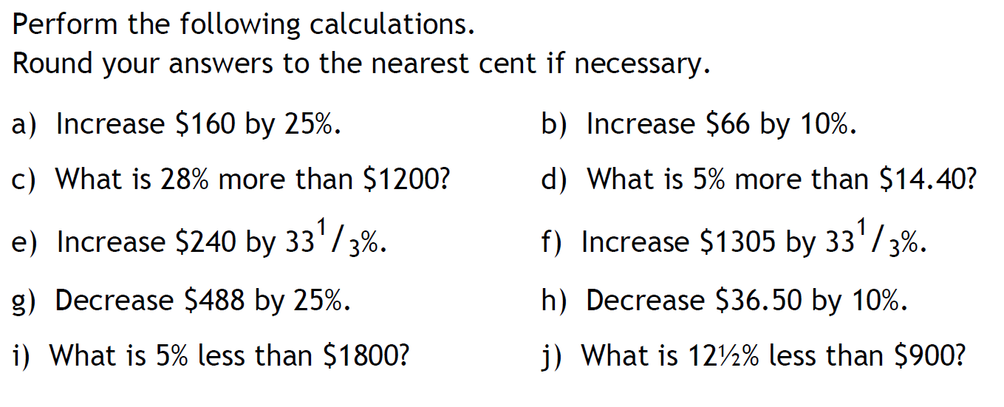
Task

Slide 7
24
7
30
Percentages Skills Review
Date: 21/08/2018
EQ – What percentage skills are expected in Year 11 Essentials?
What is profit & loss?
If a business makes money by selling an item for more than they bought it for, they make a profit.
If a business loses money by selling an item for less than they bought it for, this is a loss

Slide 8
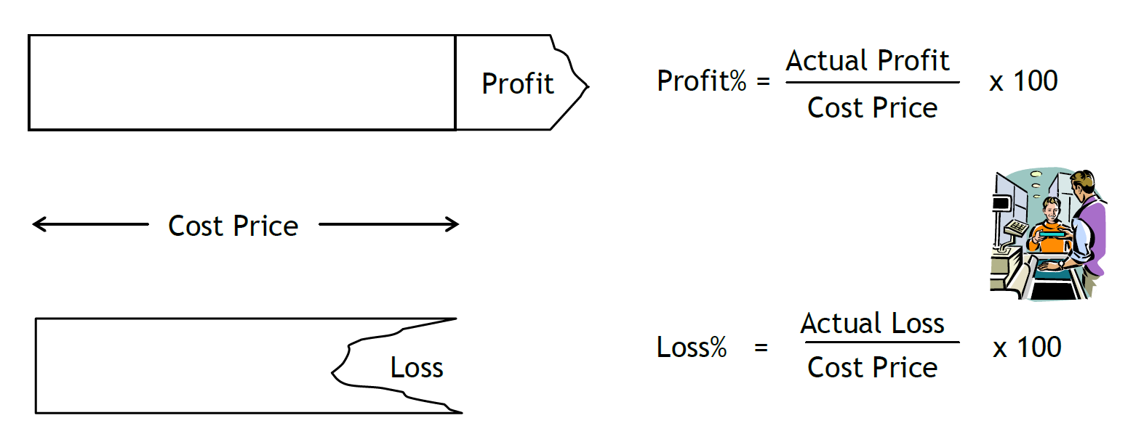
24
7
30
Percentages Skills Review
Date: 21/08/2018
EQ – What percentage skills are expected in Year 11 Essentials?
Calculating profit and loss
To calculate the profit or loss, you need to know what the selling price is and what the cost price is.
Selling price – how much the item is sold for
Cost price – how much the item was originally bought for

Slide 9
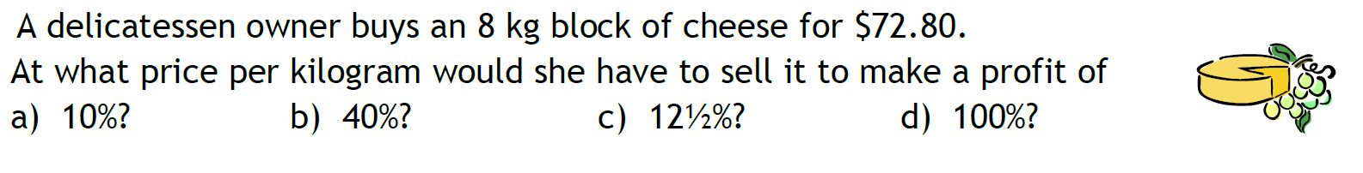
Task

Slide 10
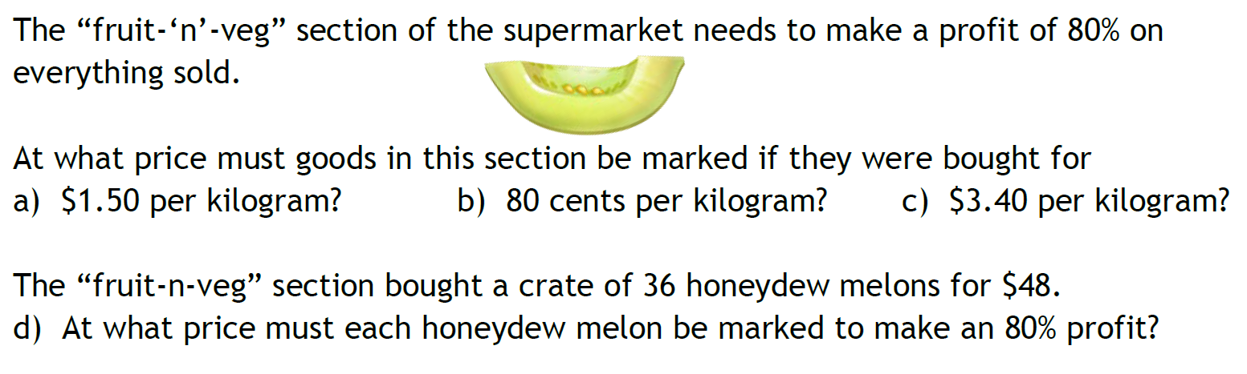
Task

Slide 11
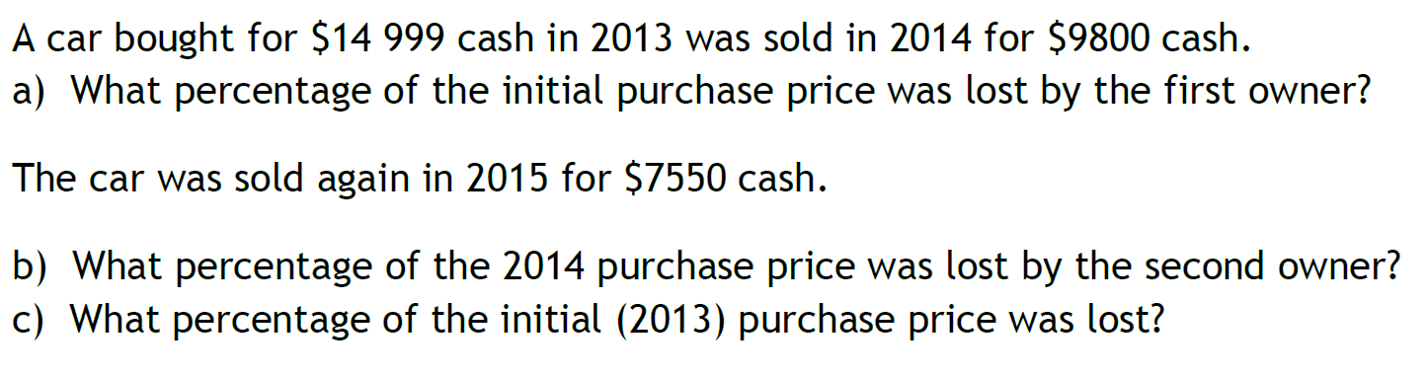
Task

